Slide 1
Non-Metallic Enclosures
2022

Slide 2
History
1920 - Founded Ghent, Belgium
Early products manufactured included Bakelite. Discovered by Leo Bakeland, used for electrical insulation applications.
1962 – nVent HOFFMAN introduces FRP enclosures in US market.
1970’s and 1980’s - Evolved into one of Europe’s most advanced FRP (Fiberglass Reinforced Polyester) molding operations
2007 – Moved VJ / RVJ Production from Ghent, Belgium to Houston, Texas. (50,000 plus square foot manufacturing facility).
2020 – KEY POINT : Expanded value-added services including Digital Imprinting, Paint Line, new CNC Machines, and a UL 508A Shop, all in-house.
2021 – nVent acquires Vynckier Enclosures
We connect and protect

Slide 3
nVent HOFFMAN FRP Enclosures
nVent HOFFMAN FRP (Fiberglass Reinforced Polyester) Enclosures are made from a hot compression mold process, utilizing a continuous, robotically poured polyurethane gasket, providing superior protection to internal contents from ingress of dust, water, moisture, and chemicals which cause corrosion. ( NEMA 4 X / IP 66)
The nVent HOFFMAN FRP Enclosure offers total protection of the contents while simultaneously protecting itself from deterioration.
KEY POINT: nVent HOFFMAN FRP Enclosures are functionally interchangeable with any other JIC enclosures used in industrial and commercial applications.
We connect and protect

Slide 4
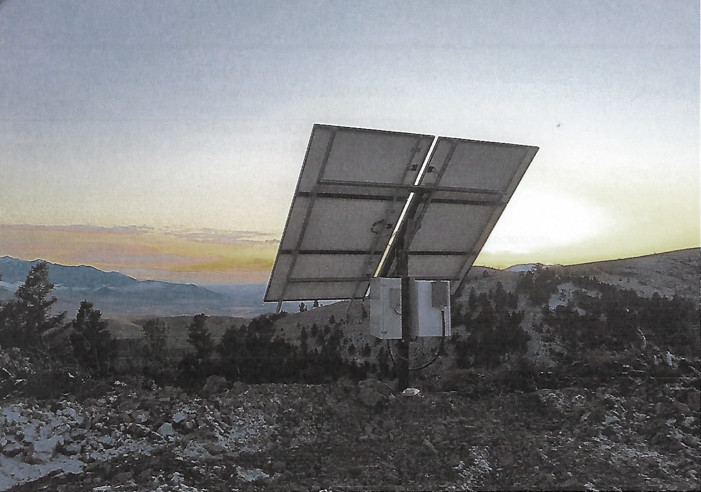
Fiberglass Reinforced Polyester Characteristics
Toughness
Non-Conductivity
Corrosion Resistance
Light Weight
We connect and protect

Slide 5
FRP Corrosion Resistance
Equal to Stainless Steel in corrosion and chemical resistance and far better than carbon steel and other nonmetallic materials.
FRP is recommended for use in most environments where Acids, Alkalines, or Solvents are present.
KEY POINT : Moisture Resistant: nVent HOFFMAN offers the industry’s highest level of UL Listed NEMA 4X integrity (no ingress of water from any angle).
We connect and protect

Slide 6
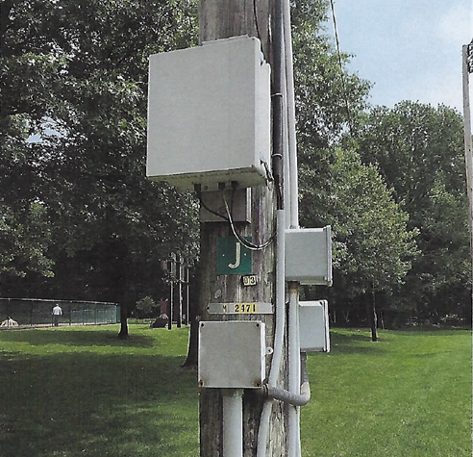
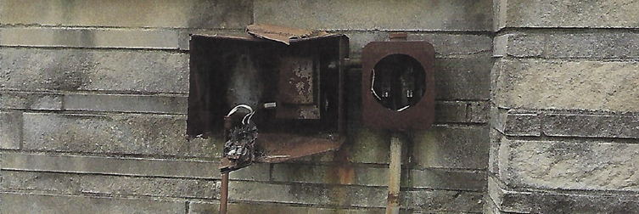
FRP Weight Comparison
FRP is light weight. It is easier to handle, less expensive to ship
and much easier to drill, punch or saw.
Material Product Weight
Fiberglass VJ1614HW 10 lbs 6 oz
Carbon Steel E16H12A 23 lbs
Stainless Steel E16H1206SS 23 lbs
We connect and protect

Slide 7
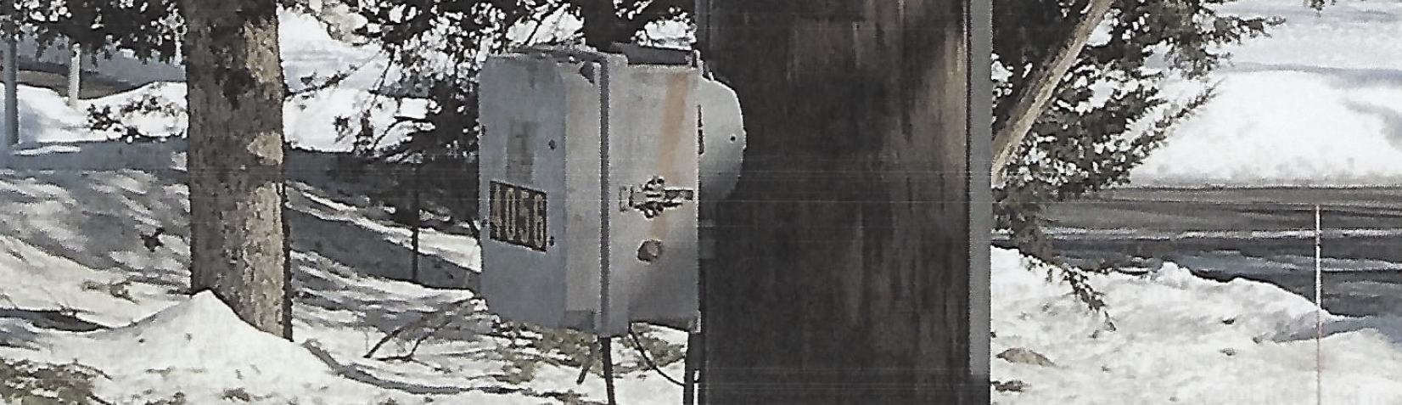
More FRP Properties worth mentioning
Antimony Oxide - Flame retardant
Aluminum Tri-Hydrate - minimizes flame propagation creating 94V-5 rating (withstands a 5” flame, required for UL746)
Aluminum Hydroxide- UV inhibitor
Premium polyester resin - takes brittleness out of the polyester - add flexural strength
On average 25% glass fibers by weight (provide toughness)
Resistance to high and low temps (-58F to 302 F)
KEY POINT : Useful outdoor life exceeds 25 years
We connect and protect

Slide 8
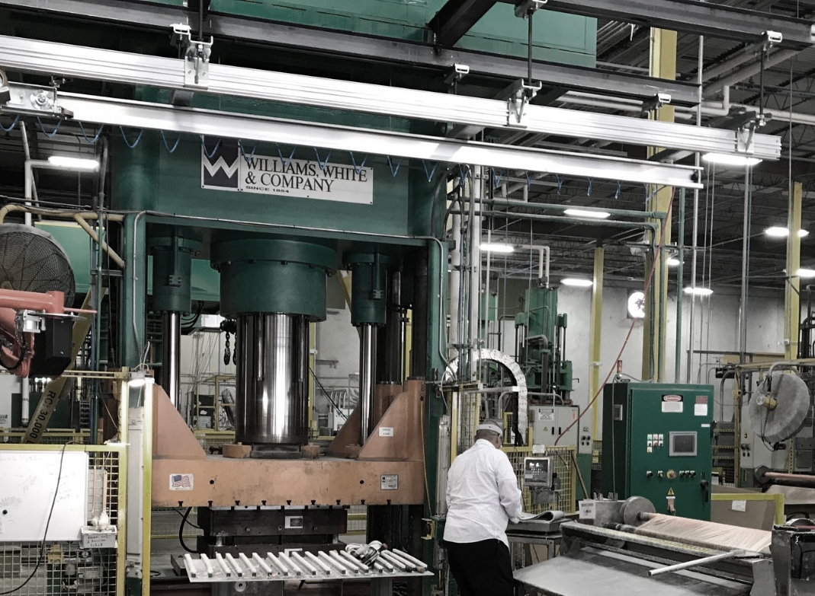
FRP Hot Compression Molding
nVent HOFFMAN uses custom tooling which produces:
Consistent Part Quality
Smooth Finish In & Out
Even distribution of glass fibers adding strength and
consistency (unlike injection / bulk molded products).
We connect and protect

Slide 9
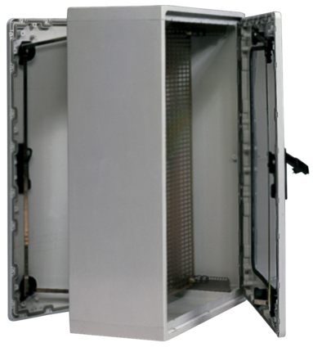
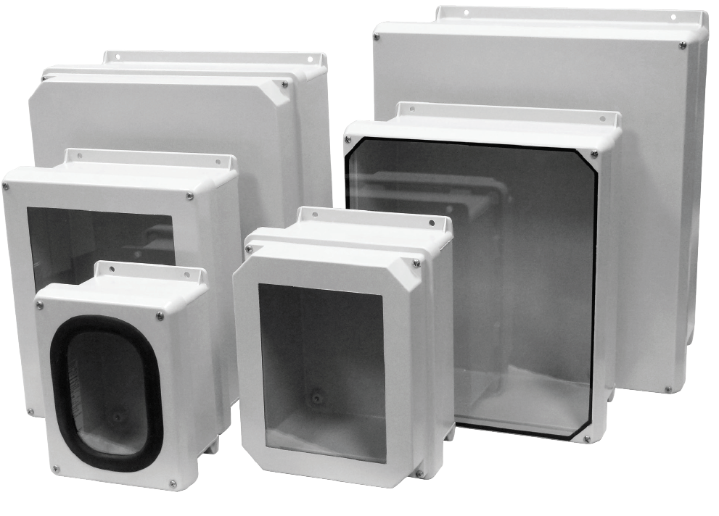
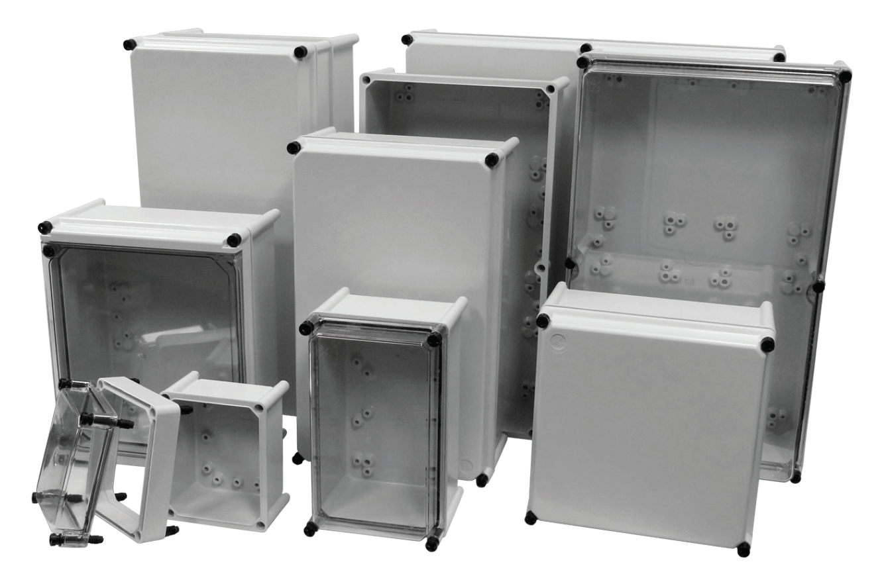
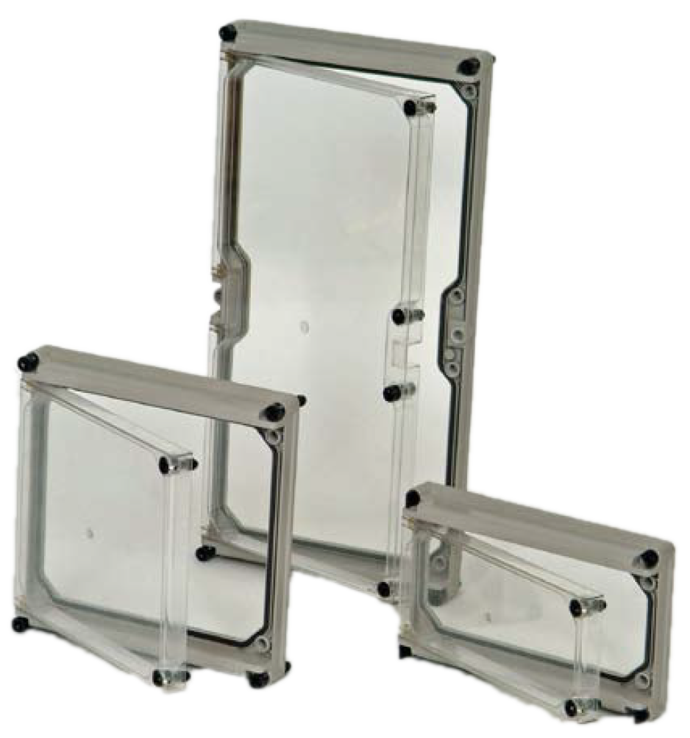
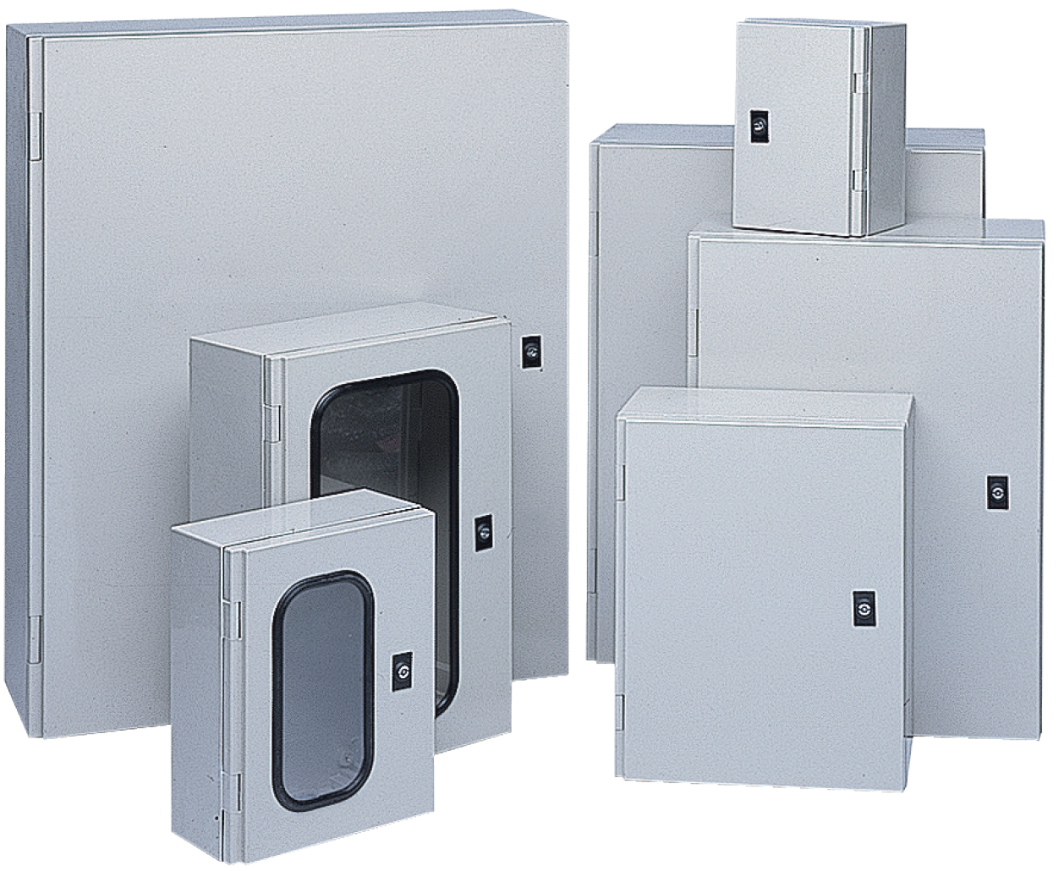
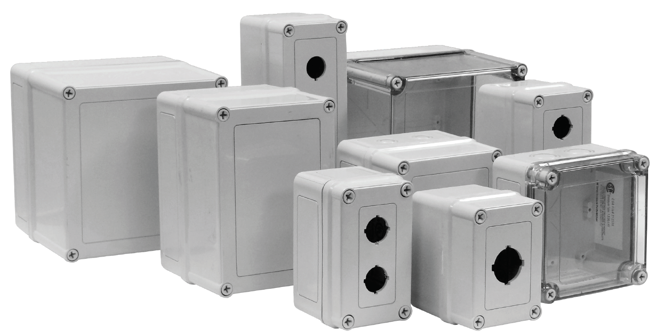
nVent HOFFMAN Product Families
VJ and RVJ
JIC instrument enclosures
APO Series
Modular enclosures and
IEC enclosure types
Polysafe
Industrial wall mount and
free-standing enclosures
ARIA Series
Industrial wall mount enclosures
DT Covers
All-surface NEMA 4X HMI windows
VM and Pushbutton Series
Small electrical enclosures
We connect and protect

Slide 10
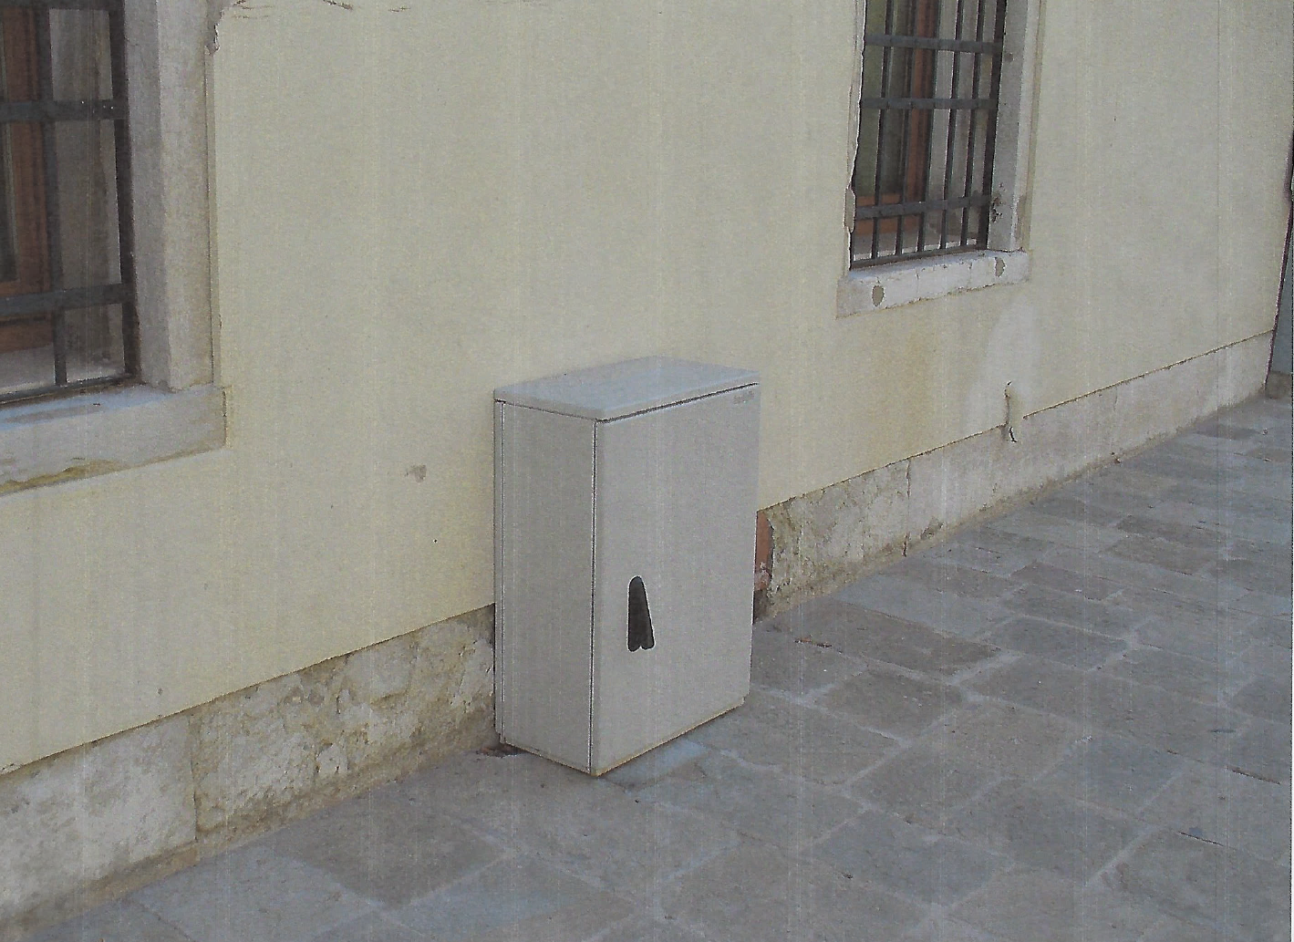
Ratings & Approvals
UL Listed NEMA Types 3, 3R, 4, 4X,12, 13
CSA 3, 3R, 4, 4X, 12, 13
CE – European rating
RoHS
Approved UL 508A Shop
NEW! UL1741 for solar applications
20 plus Global Approvals
KEY POINT : nVent HOFFMAN is accepted all over the world
We connect and protect

Slide 11
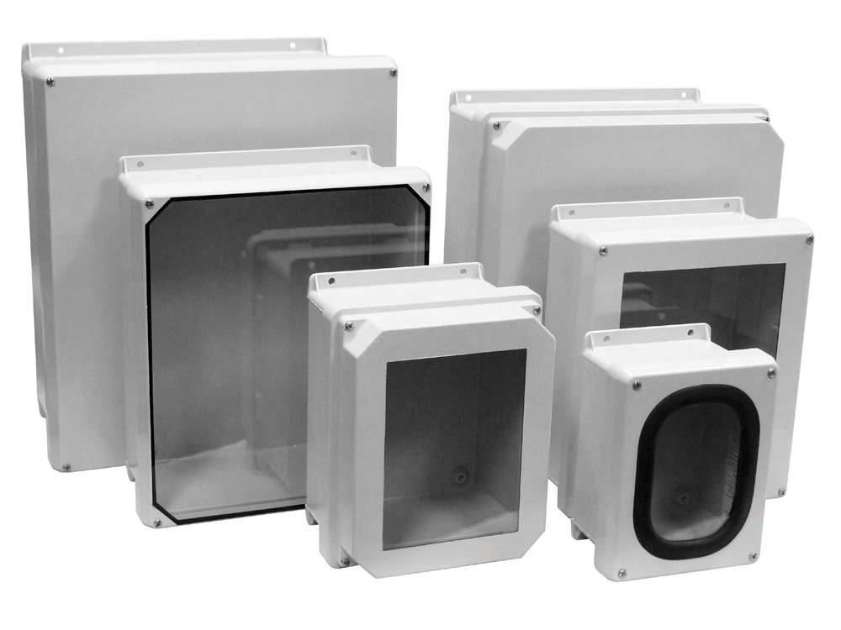
VJ-RVJ Series Overview
Designed to be used as instrument housings, junction boxes, or electrical control enclosures.
VJ Series - Flat Cover
RVJ Series - Raised Cover
Memory retaining, continuous polyurethane gasket
Integral mounting flange
Recessed, stainless steel captive cover screws
Tongue and groove closure
16 Size Selections: 6 x 6 to 30 x 24
We connect and protect

Slide 12
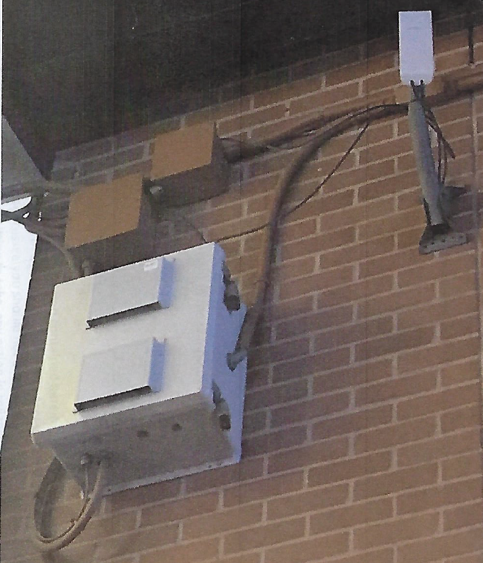
VJ / RVJ Ratings and Sizes
Series NEMA Rating Available Sizes
VJ Series 4X 6x6x4 to 30x24x11
RVJ Series 4X 8x6x6 to 20x16x11
Window Units
Gasket window 4X All VJ & RVJ Series
CVJ-Full View 4X All VJ Series
Bonded 4X All VJ & RVJ Series
We connect and protect

Slide 13
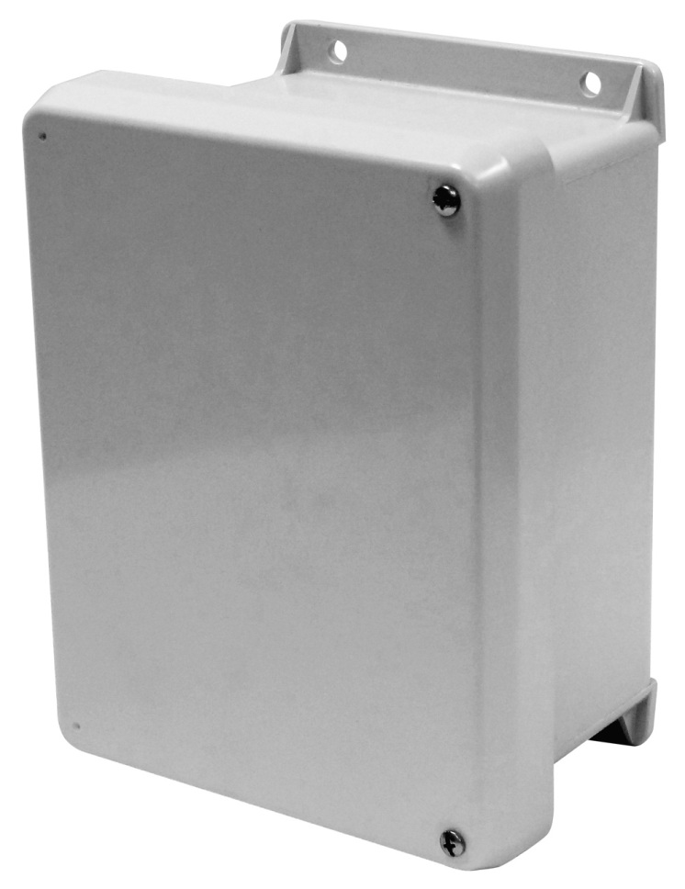
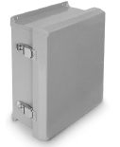
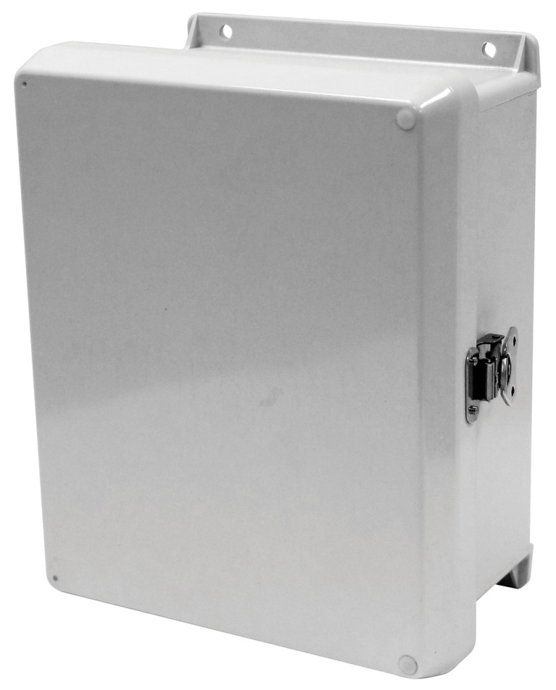
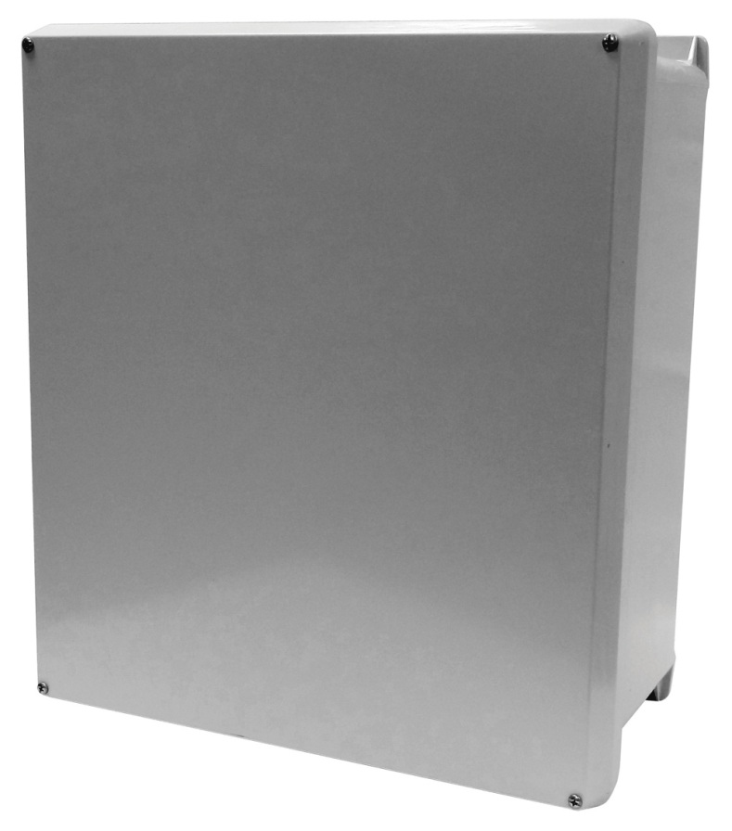
VJ Series Closure Options
W Series
4 cover screws
HW Series
Hinged w/ 2 cover screws
HWPL Series
Hinged w/ PL latch(es)
HWLL Series
Hinged w/ LL latch(es)
We connect and protect

Slide 14
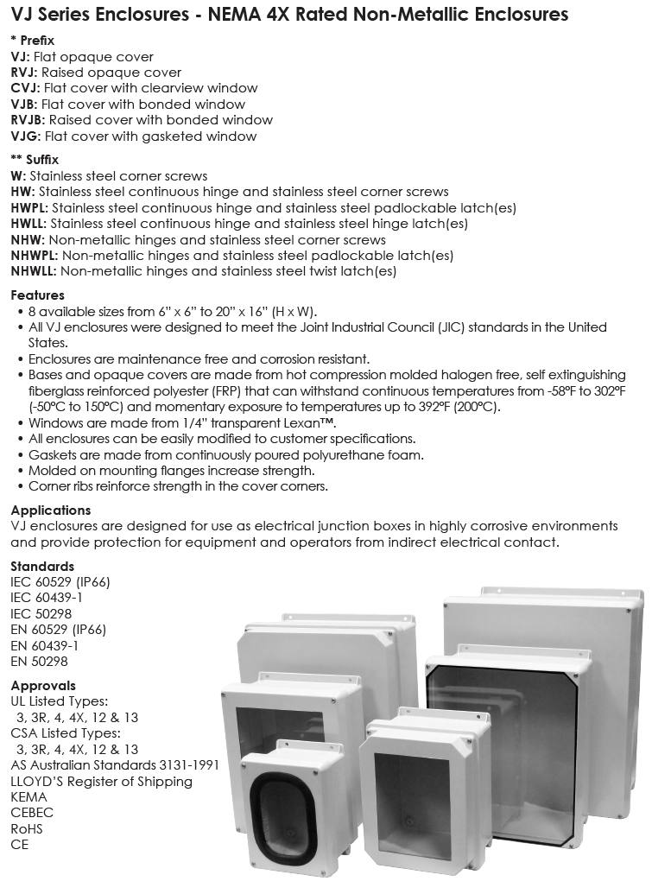
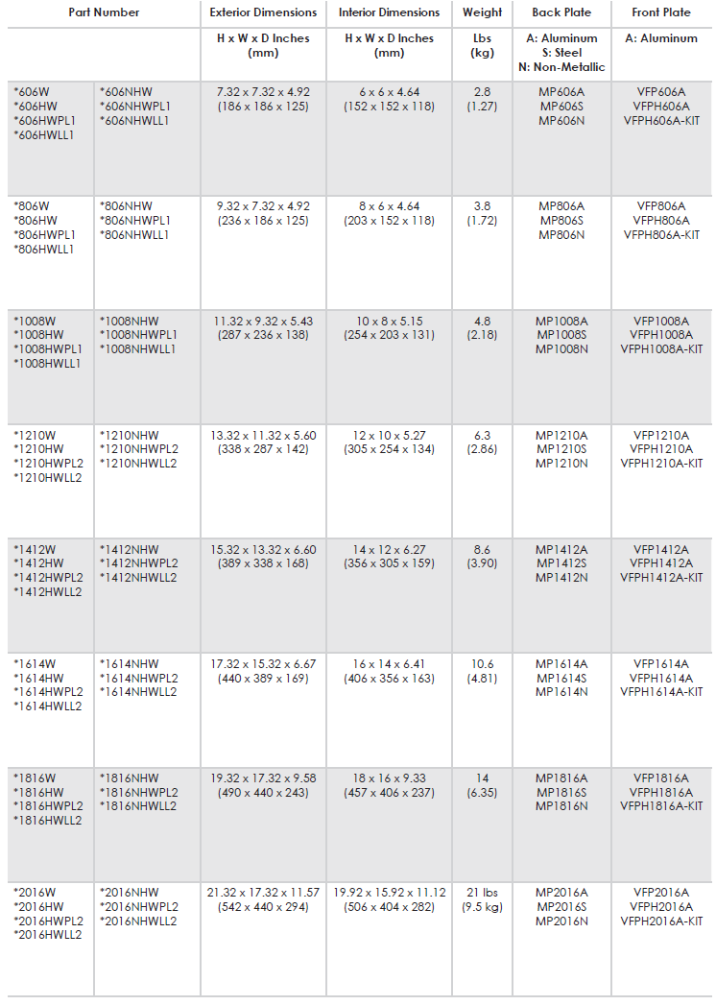
VJ Series Data Sheet / e-FILE
We connect and protect

Slide 15
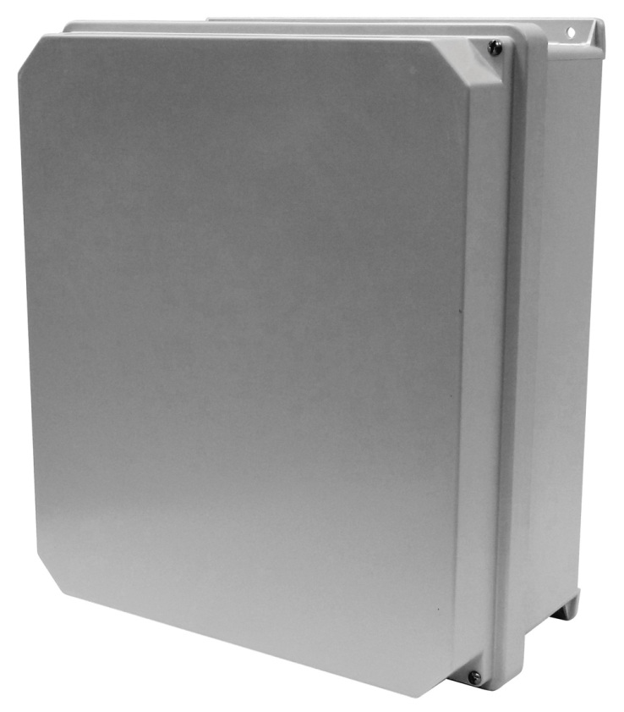
RVJ SERIES
Raised VJ Cover
Seven separate sizes
Extra Depth Enclosures (adds 1.5-3 inches extra depth)
Bonded and Gasket View Windows available
We connect and protect

Slide 16
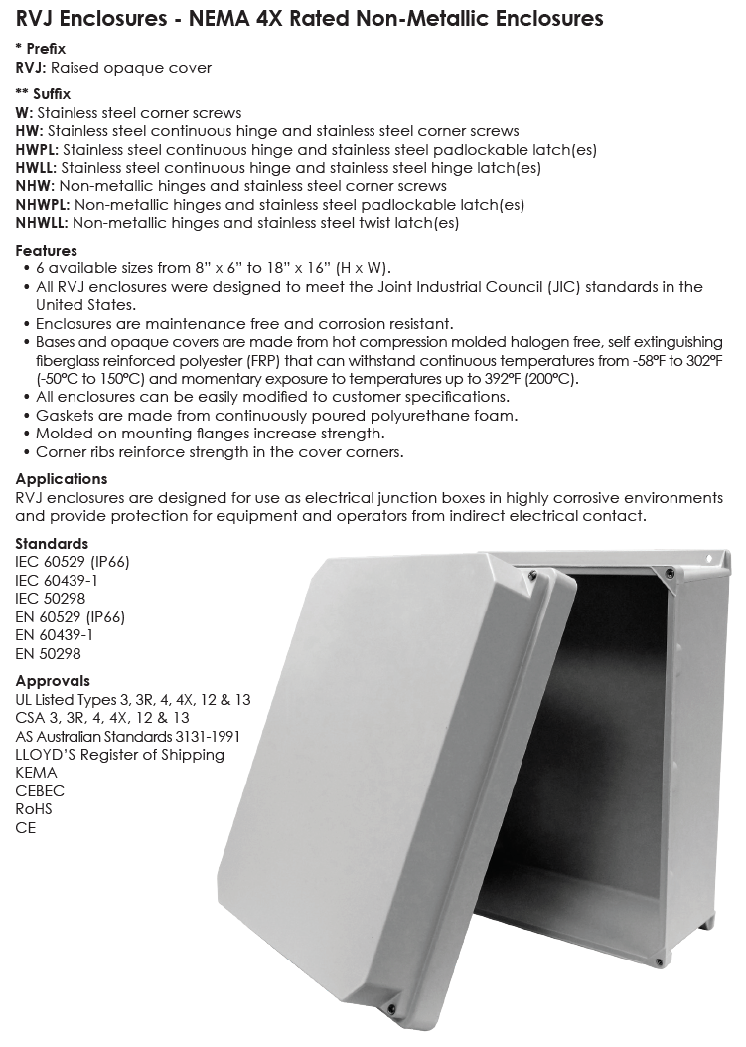
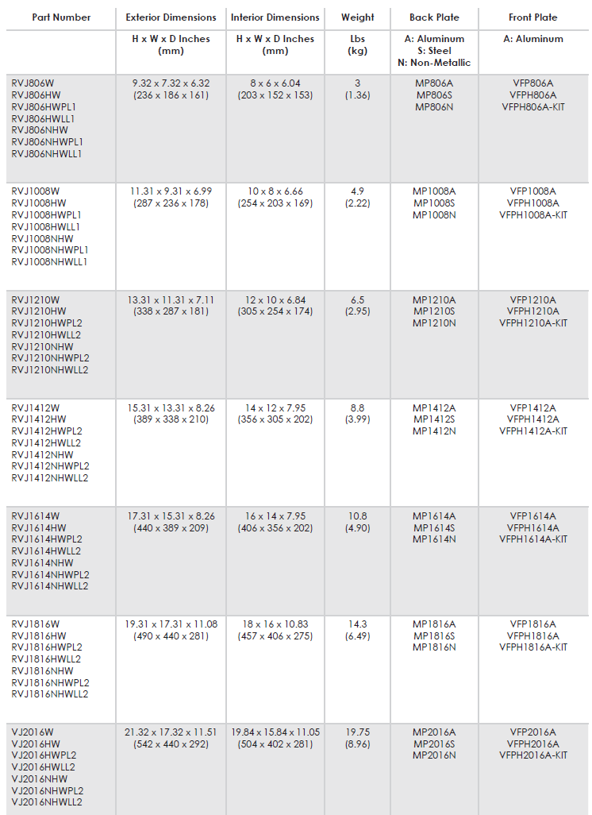
RVJ Series Data Sheet / e-FILE
We connect and protect

Slide 17
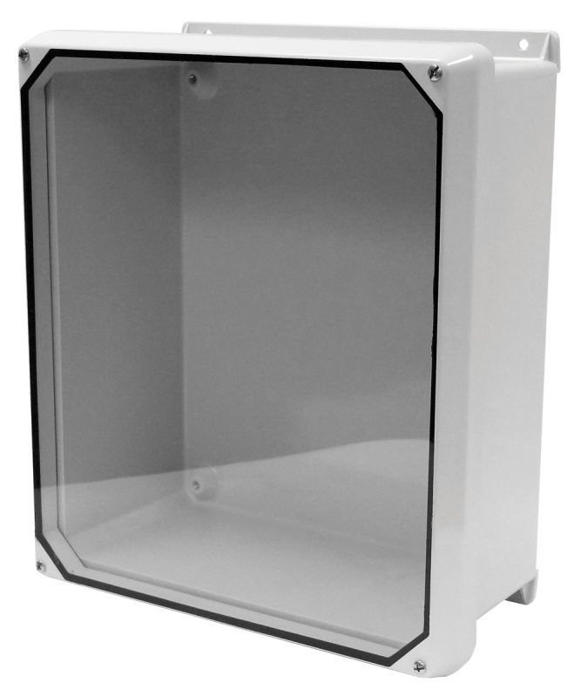
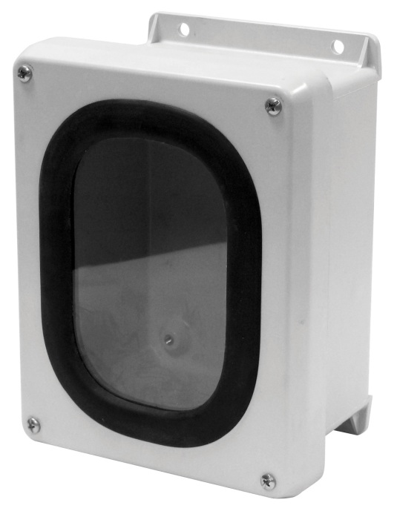
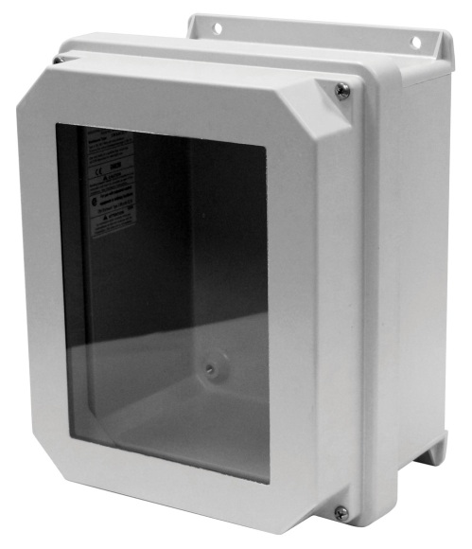
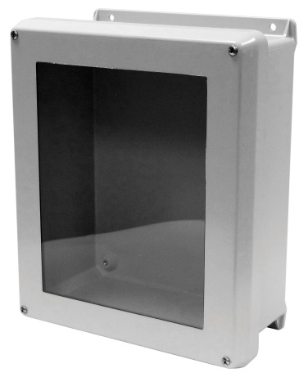
Windows Available
Bonded window in both VJ and RVJ Series
Gasket View Window
CVJ window with largest viewing area
KEY POINT : nVent HOFFMAN will cut windows to size
We connect and protect

Slide 18
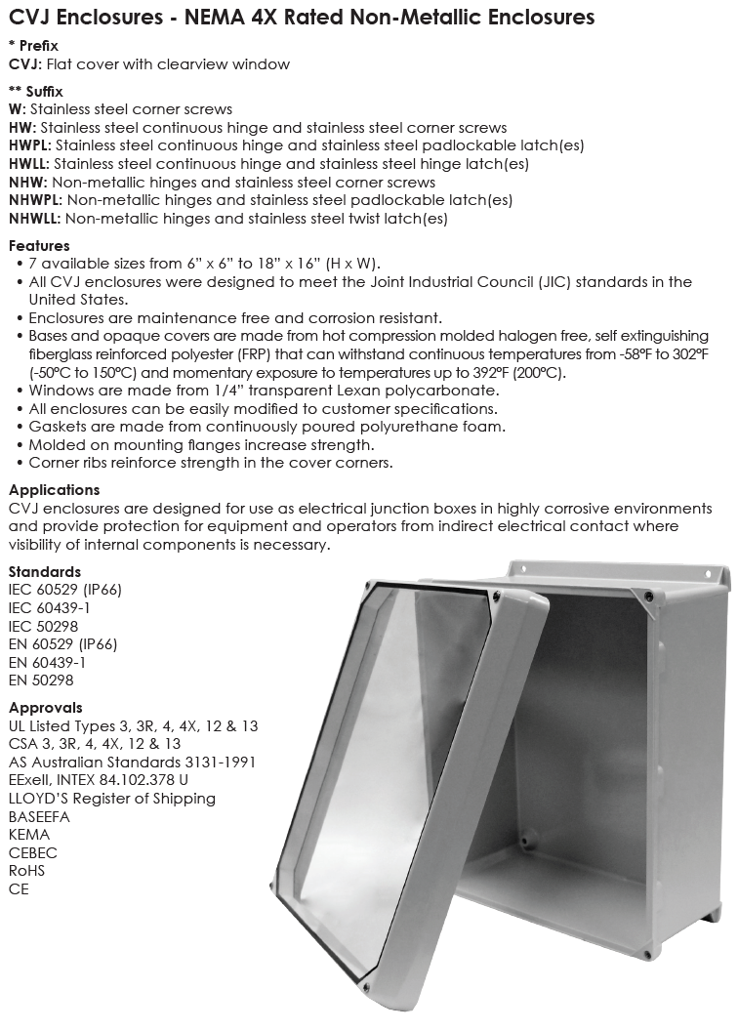
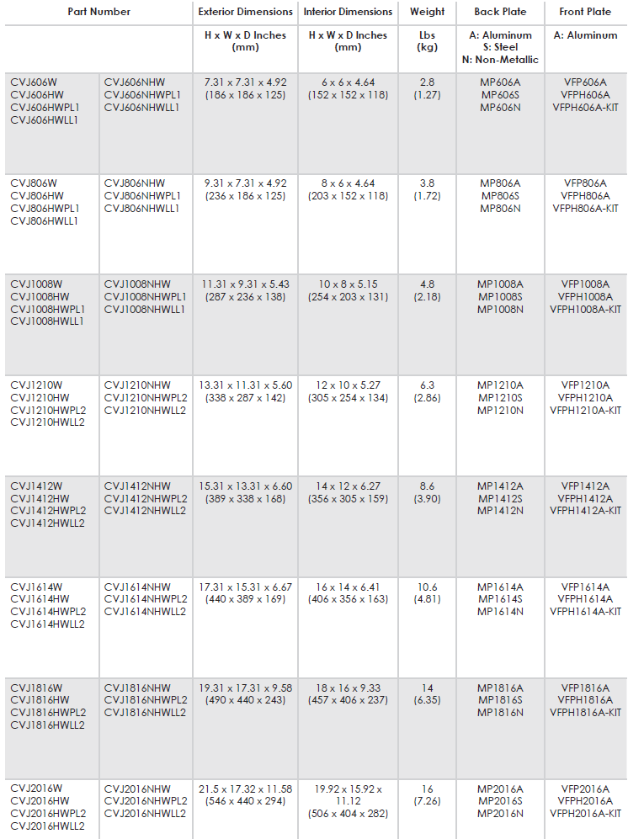
CVJ Series Data Sheet / e-FILE
We connect and protect

Slide 19
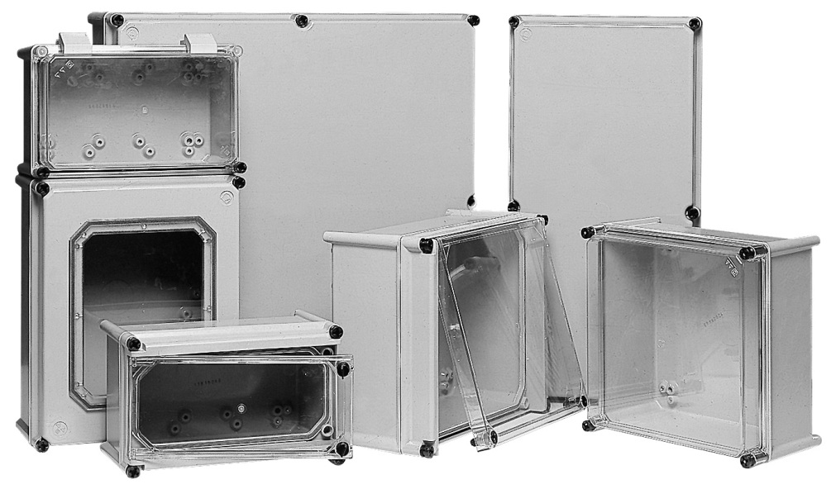
APO Series
We connect and protect

Slide 20
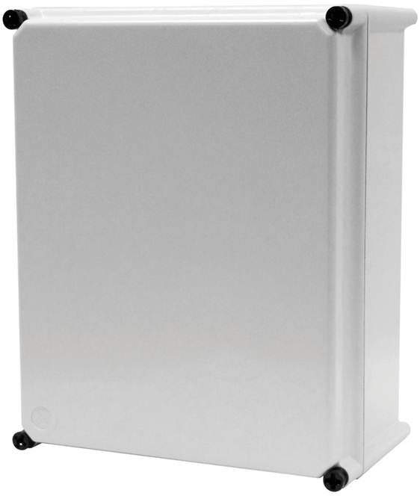
APO Series
Modular enclosures w/flush mount covers, IEC and NEMA 4X
9 Standard sizes 7x6 to 24x24
Opaque or completely clear covers
Hinge-able, lock-able, latch-able
Non-metallic cover screws (double insulation)
Extension collars for additional depths (Maintains NEMA 4X rating
with up to 5 collars)
KEY POINT : Can be coupled vertically and horizontally adding dimensional and application versatility
We connect and protect

Slide 21
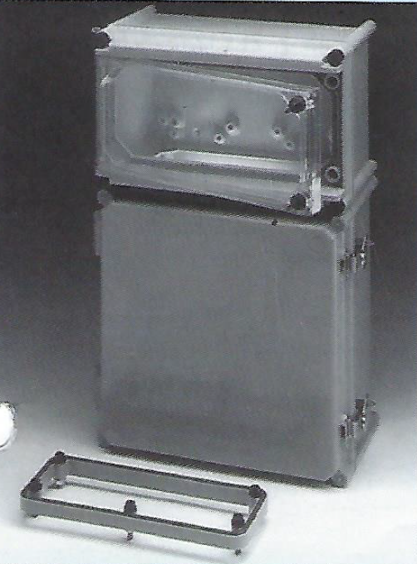
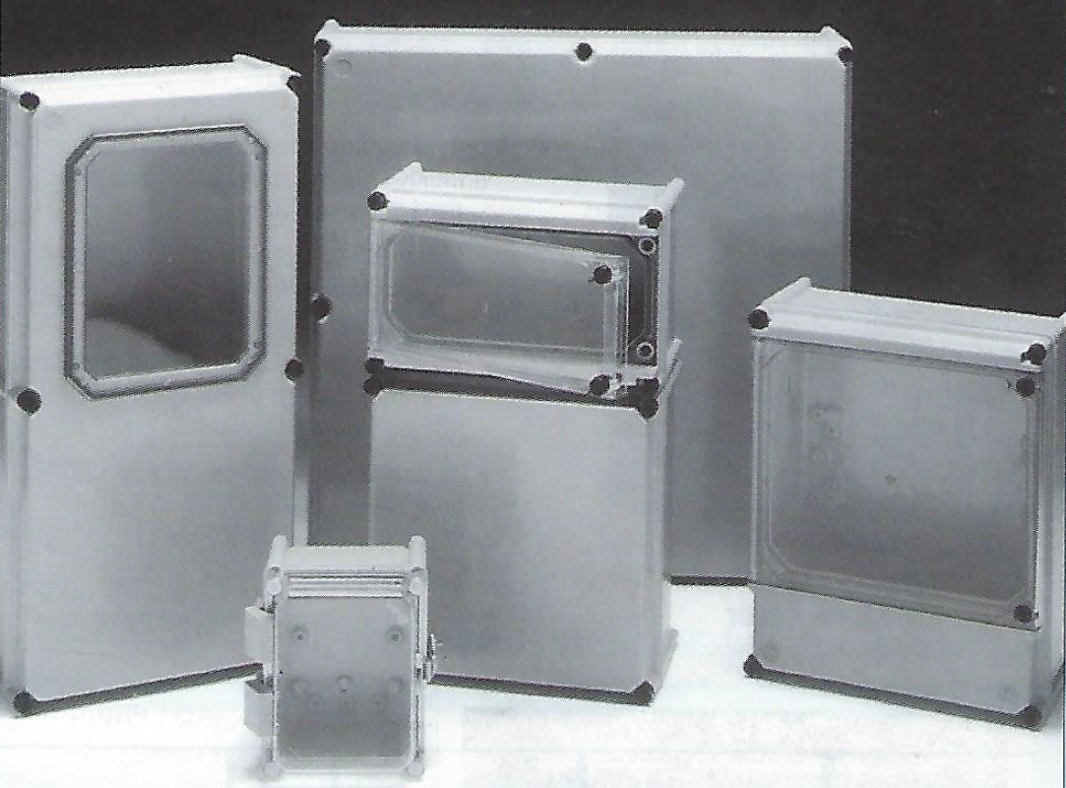
APO with clear covers, collars, and non-metallic hinges
We connect and protect

Slide 22
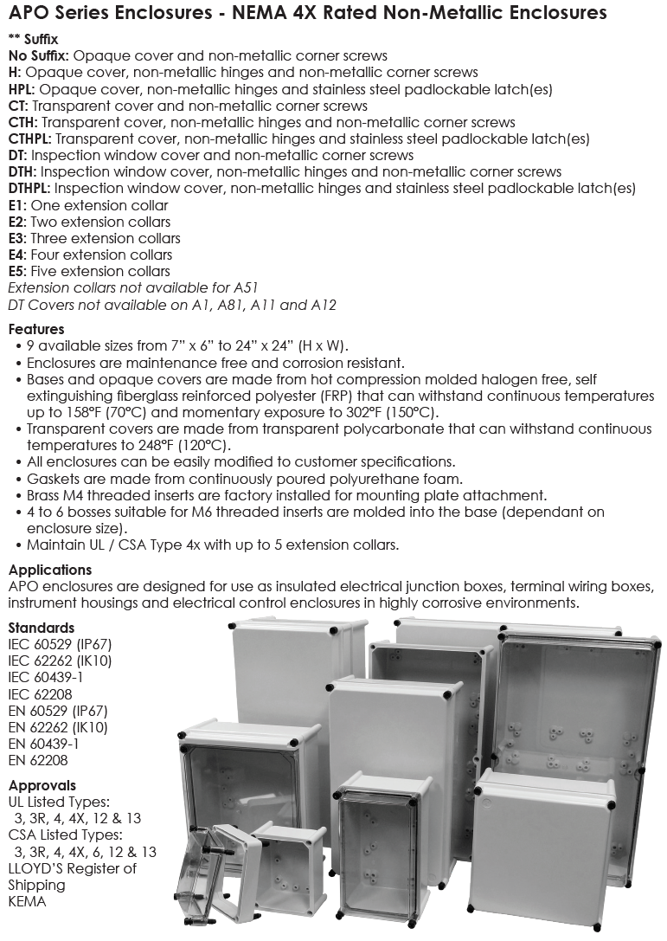
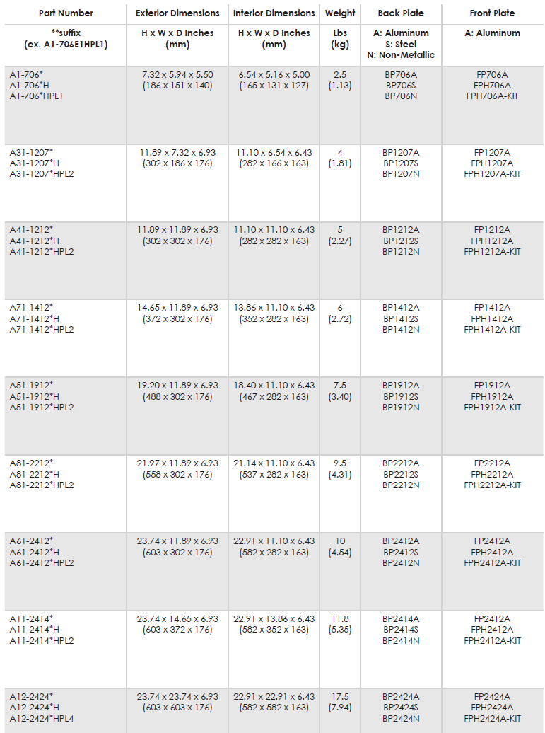
APO Series Data Sheet / e-FILE
We connect and protect

Slide 23
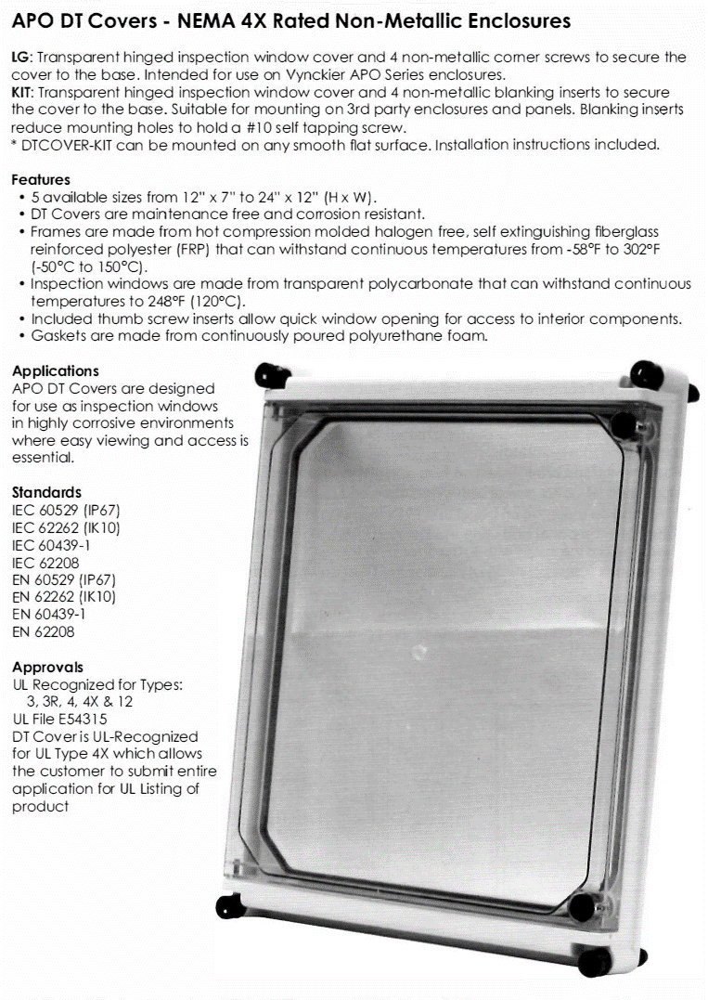
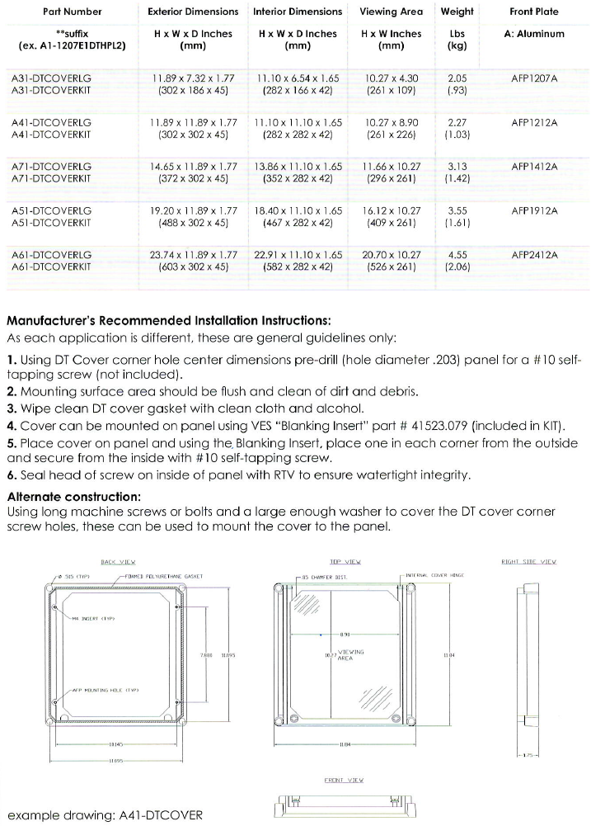
DT Cover Data Sheet / e-FILE
We connect and protect

Slide 24
ARIA and POLYSAFE Series Wall mount and freestanding enclosures
7 sizes
12x8 to 40x32
UL listed and
NEMA 4x rated
ARIA
10 Standard sizes
20x20 to 50x30
Coupling ability
Coupled or uncoupled
All are UL &
NEMA 4X Rated
POLYSAFE
We connect and protect

Slide 25
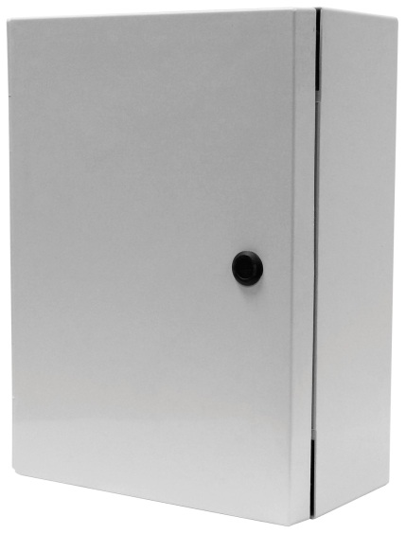
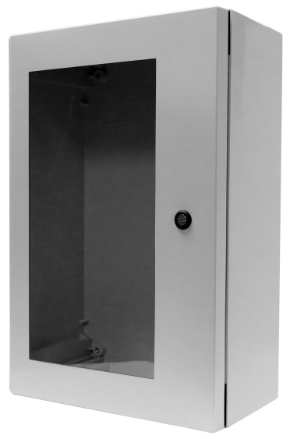
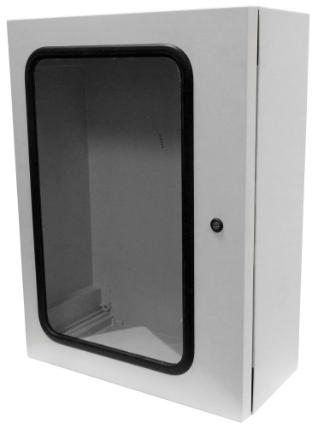
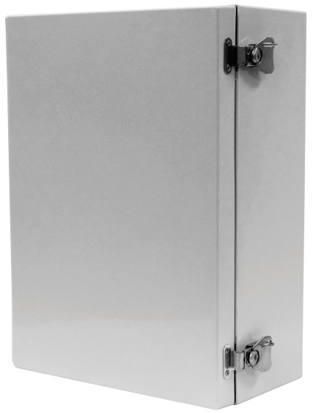
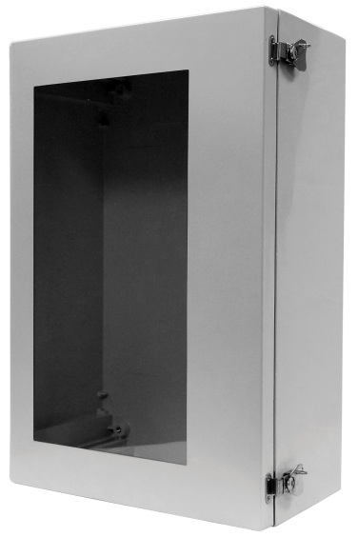
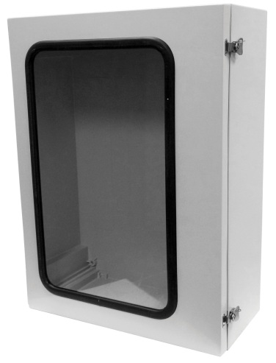
ARIA Series Products
We connect and protect

Slide 26
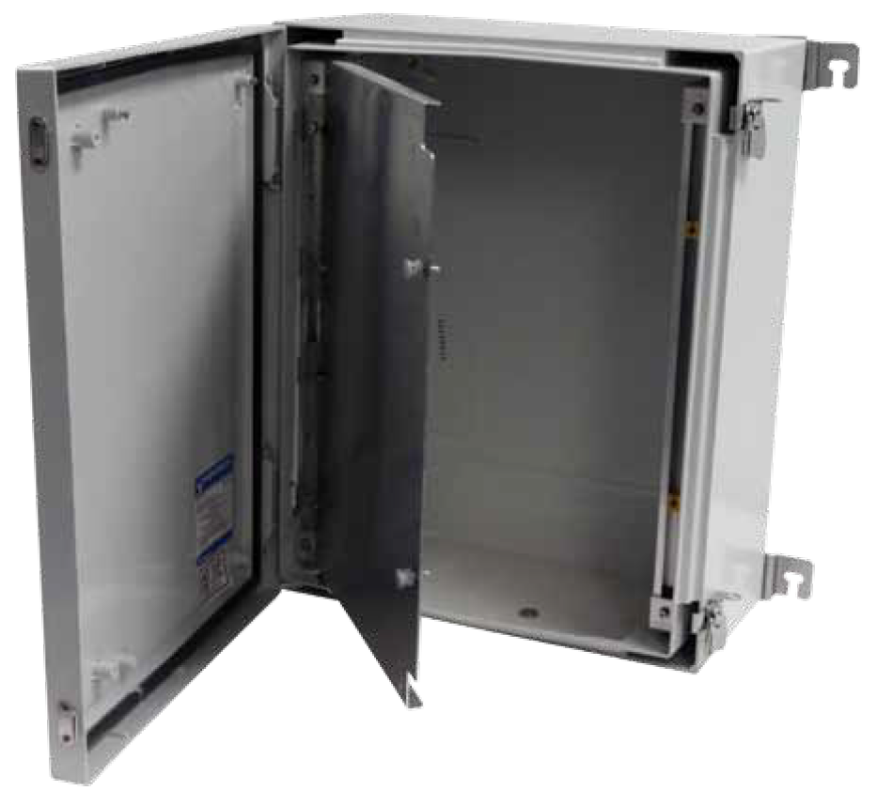
ARIA Series
Cabinet style wall mounted enclosure
Removable doors for easy installation of components
Dead-front capabilities
Stainless steel & non-metallic mounting feet
Single piece body design
Concealed hinge design
Accessory ready enclosure (din rail slide, standoffs, etc.)
Double walls for insulation
We connect and protect

Slide 27
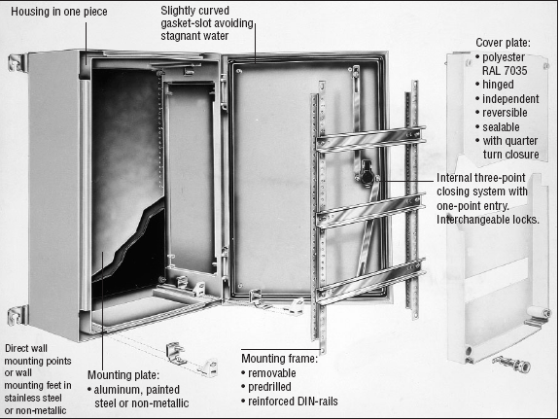
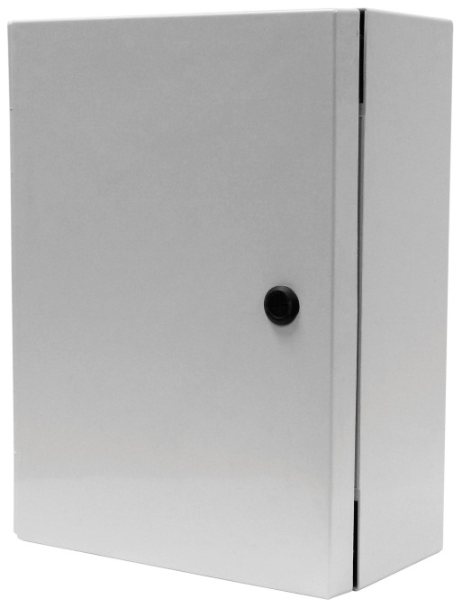
ARIA Series
7 Standard sizes available –12x8 to 40x32
Multiple latching & window options available
UL Listed & NEMA 4X Rated
We connect and protect

Slide 28
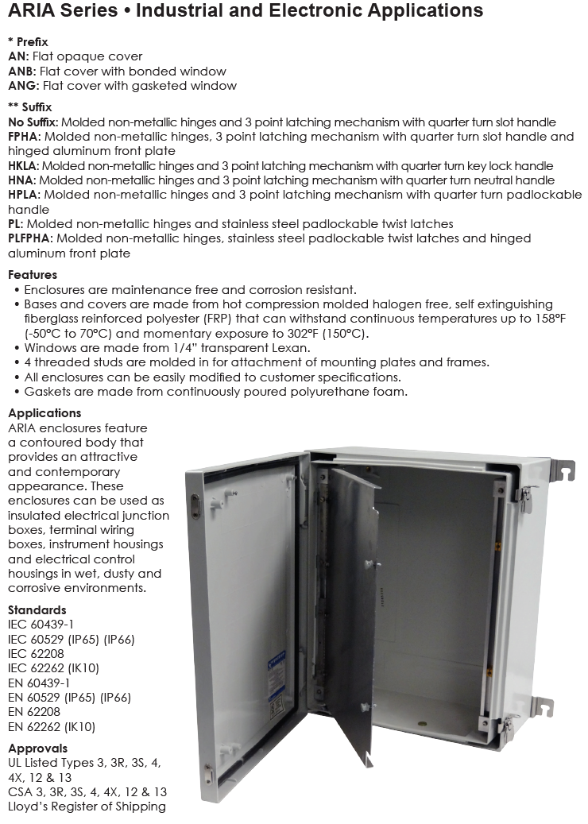
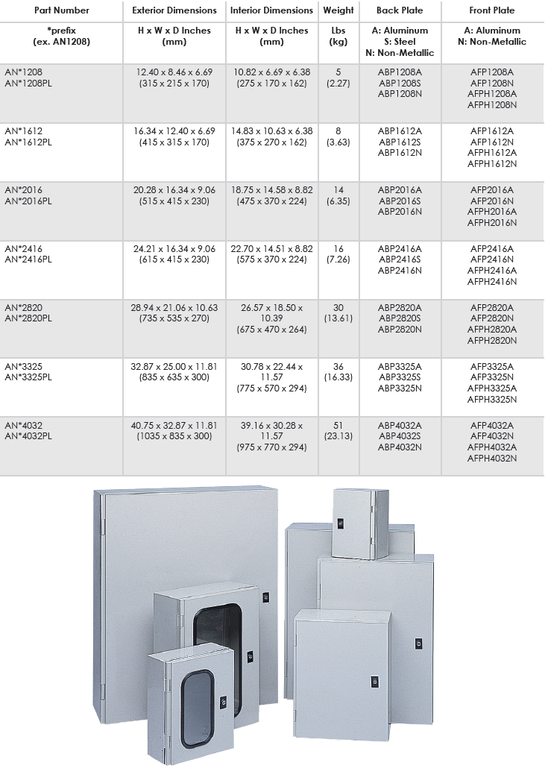
ARIA Series Data Sheet / e-FILE
We connect and protect

Slide 29
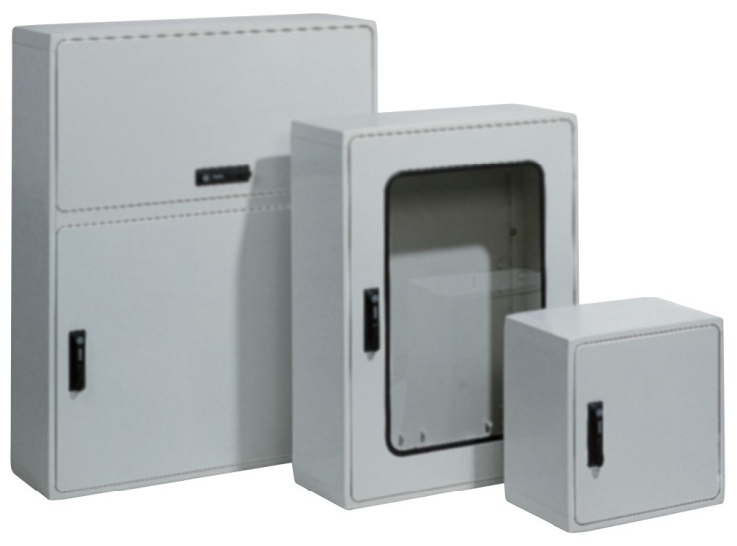
POLYSAFE Enclosures
We connect and protect

Slide 30
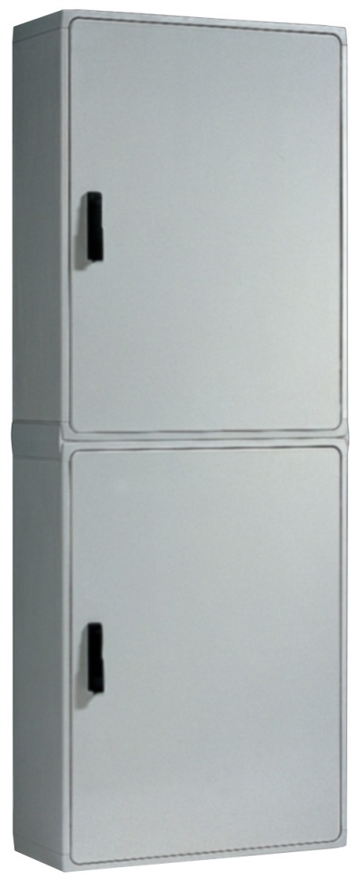
POLYSAFE Series
KEY POINT : 9 LARGE standard sizes 20x20 to 50x30
Wall mounted or free standing
3-point or 5-point latching, door lifter
Window units available
19” Rack mount & dead-front capabilities
Depth extension in 12” increments (up to 3)
Horizontally or vertically coupled
Accessible from front and back
We connect and protect

Slide 31


Flexibility for Sizes or Configurations
We connect and protect

Slide 32


POLYSAFE Series Data Sheet / e-FILE
We connect and protect

Slide 33

VM and Pushbutton Series
We connect and protect

Slide 34





VM Series
We connect and protect

Slide 35
VM and Pushbutton
13 Standard sizes available
Corrosion & impact resistant Valox (357U) polycarbonate and polyester mix = stronger and more impact resistant
Flush mount covers: opaque or clear options
Memory retaining, seamless polyurethane tongue & groove gasket for tight seal
Series available with 30mm and 22mm pushbutton holes
1 to 6 holes available
Custom modified configurations also available
IP66 and NEMA 4X Rated
We connect and protect

Slide 36

VM and Pushbutton Series
Ideal for the instrumentation industry
Ideal for Electronic industry
Various cover depths available
Can be modified to specifications
UV Stabilized
KEY POINT : Made in Texas, USA
We connect and protect

Slide 37


VM Series Data Sheet / e-FILE
We connect and protect

Slide 38
General Accessories (for all enclosures)
Back Plates: Painted Steel, Aluminum and Non-metallic
Latches: twist and pad lockable
Handles (key lock & padlock)
Front Panels hinged and stationery (dead front)
Din Rail
Grounding
Instrument Windows
Threaded Inserts
Egress Glands
Venting options
Terminal Lugs
Stand Offs for VJ and APO
Terminal Strips
We connect and protect

Slide 39

Value Added Services
nVent HOFFMAN will customize an enclosure to the customer’s unique specifications, including:
Holes, custom windows, and special cut outs on enclosures, panels, and dead front panels
Variety of latches and door lock options
Digital Imprinting (logos, instructions, QR codes, etc.)
Custom Colors (paint or molding pigment)
Recognized UL508A Listed Shop & Services available
We connect and protect

Slide 40

Enclosure Modifications
Countersinking
Counterboring
Holes
Cut-outs
Venting
Windows standard and custom
Digital Imprint
Custom Colors (paint or mold pigment)
We connect and protect

Slide 41
Countersunk Holes
Allows a flat head screw to be flush to the surface of the cover
Creates a hole with angled sides, instead of standard straight sides
Can be done on cover or on base of enclosures
Holes are available in any size
Countersunk hole
Normal hole
Side view
We connect and protect

Slide 42
Counterbored Holes
Allows a pan-head screw to be flush to the surface of the cover
Creates a hole with straight, widened sides
Can be done on cover or on base on the inside or outside
Counterbored hole
Normal hole
Side view
We connect and protect

Slide 43
Cutouts
Cut-outs are rectangular or square in shape
Cut-outs may have a corner radius
Rounded Corner / Square Corner options
Rounded Corners are nVent HOFFMAN Standard
Square Corners (secondary process)
We connect and protect

Slide 44

Enclosure Ventilation
Ventilation of an enclosure is achieved
through the use of vents and drains:
MEDVRAL7035 (UL Type 3R)
SEDV
RDV
Louvered Vents
We connect and protect

Slide 45

In-house Digital Imprint
Digital Imprint can be placed anywhere on the cover or panel. Logos, safety info, instructions, pictures, QR codes, and more.
Unlimited color options (exact color matching w/full
CMYK printing)
Long lasting and UV resistant designed for indoor and
outdoor environments
Saves money, time, and labor
No minimum orders
Improved quality w/reduced lead times
Customer supplies artwork (digital file, scalable file, jpeg, png, etc. are all acceptable)
Printing on FRP, aluminum, painted steel, stainless steel, lexan, plexiglass, and more
KEY POINT : Printed in nVent HOFFMAN’s Houston, TX facility… easy, efficient, economical!
We connect and protect

Slide 46
Digital Imprint Data Sheet / e-FILE
Branding and labeling made easy with nVent HOFFMAN digital imprint.
Fast Turnaround
Orders ready in days, not weeks
No minimums, print 1 or 1000
Unlimited Color Options
Full CMYK printing
Exact color matching
Logos, warning labels, safety information, instructions, pictures, QR codes and much more
Flat Surfaces Up to 5.5” High
VJ and RVJ covers, ARIA doors, Polysafe doors and side panels, APO covers and DT Covers
FRP, aluminum, painted steel, stainless steel, lexan, Plexiglas and more
Long-Lasting and UV Resistant
High quality UV curable ink
Excellent adhesion properties
Designed for use in indoor and outdoor environments
Save Money, Time and Labor
No set up or tooling charges
Eliminates the need for expensive silkscreen outsourcing
Replaces expensive and difficult to install adhesive back overlays
Printed in the USA in our Houston factory location
We connect and protect

Slide 47




Custom Painting / UVP Data Sheet / e-FILE
UV Protection Made Easy with nVent HOFFMAN Paint Services.
Fast Turnaround
Orders ready in days, not weeks
Any quantity, paint 1 or 1,000 *
* Short run fee applies to orders less than 25 pieces
Color Options
All RAL Colors available (lead times may vary)
Grey, Clear, Safety Yellow & Safety Red are Factory Stock
UVP Benefits
Outdoor and UV Rated for any environment
Adds long-lasting, like new appearance to any nVent HOFFMAN Enclosure Series
Prevents chalking, discoloration & loss of gloss
Save Money, Time and Labor
No set up or tooling charges
Eliminate costly outsourcing
Painted and Quality Checked at nVent HOFFMAN - USA in Houston, Texas
We connect and protect

Slide 48

Competitive Analysis
We connect and protect

Slide 49

Target Users
Who are nVent HOFFMAN FRP enclosure customers?
Design & Production Engineers
Maintenance & Facility Engineers
Instrumentation Producers
Electrical Installers
Panel Builders
Control Engineers
Maintenance, repair, and overhaul (MRO)
We connect and protect

Slide 50
What are the target applications?
Any industry where the enclosure installation will have incidental or prolonged contact with chemicals, chemical vapor, any state of water (steam, vapor, mist, ice, fog, and standing, running, splashing, or pressure projected water).
We connect and protect

Slide 51

Target Industries
Industries
Applications
Water/Wastewater treatment
Petrochemical
Chemical processing
Marine
Food processing
Utility/Power Generation
Solar/Renewable Energy Sources
Telecommunications
Security
Mining
Electrical and Electronic panels
Pumping
Grinding
Purification
Conveying systems
Data acquisition/monitoring (SCADA)
Remote control operations
Flow Controls and
Temperature Monitoring
We connect and protect

Slide 52
Standard Industrial Classifications
Key S.I.C. Codes
2000 Food & Kindred Products
2600 Paper & Allied Products
2700 Printing & Publishing
2800 Chemicals & Allied Prod
3100 Leather tanneries
3300 Primary Metal business
3500 Industrial Machinery
3600 Electric/Electronic Equip
3700 Aeronautics & Aviation
3700 Transportation Equip
3800 Instrumentation
3900 Miscellaneous & Signs
4000 Railroads
5000 Electrical apparatus & equipment
We connect and protect

